Slide 1


NEURO FUZZY CLASSIFICATION
FOR DATA MINING TASKS
8th Semester Major Project Report
Project Supervisor: Submitted By:
Prof. Himansu Das Shalini Jaiswal (1505062)
(KIIT University) Priyanka Mahato (1505049)
(B.Tech (CSE))

Slide 2

Introduction
Neuro-Fuzzy Systems which are a combination of soft computing and machine learning techniques are used in disease diagnoses like brain disorder, cardiac disease, breast cancer, alzheimer, thyroid disorder, leukemia, hypertension.It is also extensively used in medical image classification and recognition.
One of the shortcomings of Fuzzy Logic is that it is very time consuming so feature reduction techniques such as Principal Component Analysis ,Linear Discriminant Analysis and Independent Component Analysis is used and the results are recorded.
Finally feature selection algorithm called Differential Evolution optimization algorithm is also used and the a comparative study is performed.

Slide 3
Models Used
ANN NF ANN-PCA NF-PCA ANN-LDA NF-LDA ANN-ICA NF-ICA DEA
Datasets Used for the Data Mining Task in which one is iris data set and three disease classification datasets:
Pima Indian diabetes
Breast Cancer Wisconsin (Diagnosis)
Breast-Cancer-Wisconsin
Mammographic Mass
Thyroid
Blood Tansfusion Service Center
Heart-statlog
Lung-cancer
SPECTF heart
Haberman
Liver
Hepatitis
Titanic
Wine
Hayes Roth

Slide 4

Literature Survey
According to the works of Jack V.Tu , Neural Networks provide better statistical modelling than logistic regression, less formal statistical training, implicitly detect complex nonlinear relationships between dependent and independent variables.
The disadvantages of neural network were also stated in his paper which included need of a large large dataset, “black box” nature, greater computational burden, proneness to overfitting.
According to Pal, S. K., & Ghosh, A the main advantages of FNN are (1) the ability to learn from experience, (2) a high computation rate, (3) the easily understandable manner in which knowledge acquired is expressed and (4) a high degree of robustness and fault tolerance.
According to the works of Hervé Abdi the goal of PCA is to extract the important information from the data table and to express this information as a set of new orthogonal variables called principal components.So it removes the unwanted data which reduces the analysis time.

Slide 5
Artificial Neural Network :
An artificial neural network is data processing methodology whose basic building block is a neuron whose name/property /behaviour is adopted from the neurons in the human brain.
Feed Forward Propagation of Information
h1
X1
h2
y
X2
h3
Output Layer
X3
h4
Input Layer
Hidden Layer
Back propagation of error
Figure : The Artificial Neural Network

Slide 6
Transfer Function :
Activation Function :
Working Principles
Assign Weights to the linkages between the input layer and the hidden layer.
Use the input nodes and linkages to find the activation rates of the hidden layer after which the activation of the output nodes can be found. This entire process is called feed-forward in Neural Network.
The error rate at the output node is found and thus the values of the hidden layer nodes ,output nodes and linkages are adjusted to reduce the output error rate.This is called Backpropagation.
The process of feed-forward and backpropagation are repeated till the required criteria is met and the error is minimised.

Slide 7
Working of Artificial Neural Network

Slide 8
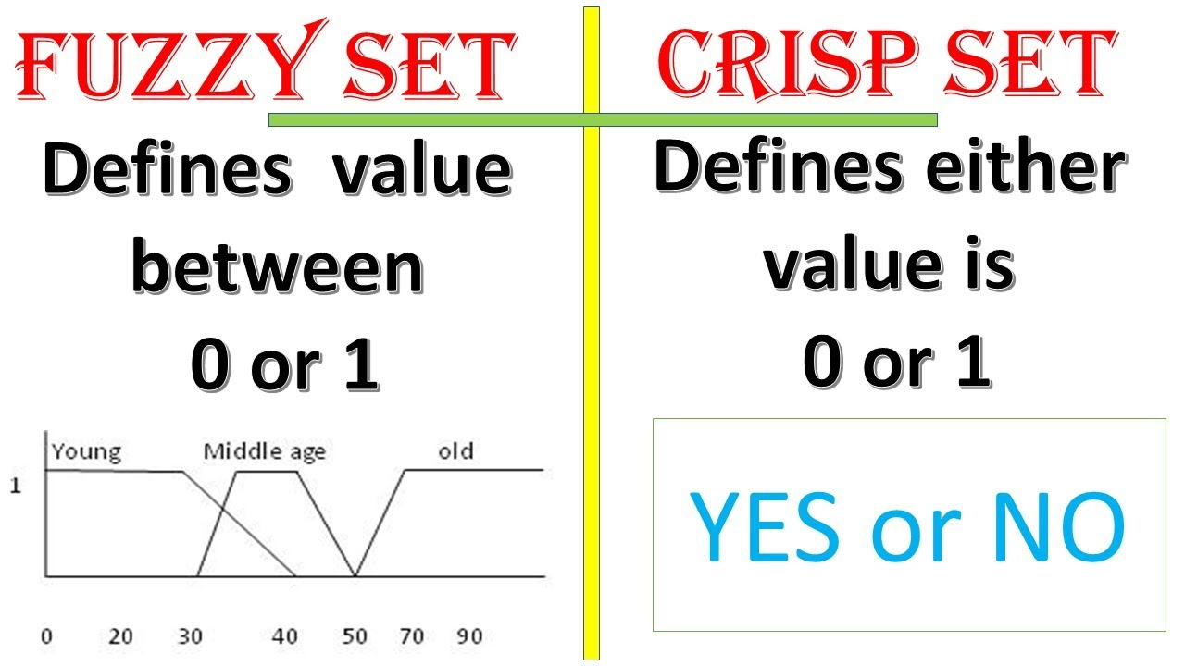
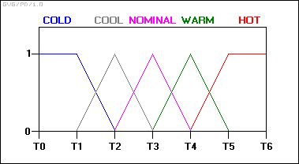
Fuzzy Logic:
Fuzzy logic is a form of many valued logic.
Fuzzy logic has rapidly become one of the most successful of today's technologies for developing sophisticated control systems.
Fuzzy logic addresses such applications perfectly as it resembles human decision making with an ability to generate precise solutions from certain or approximate information.

Slide 9
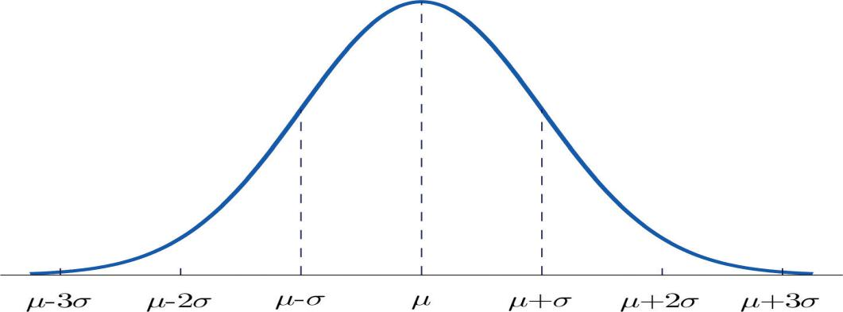
Bell Membership Function :
1
0.5
a p r q b
p = mean(n) - [max(n)-min(n)]/2
q = mean(n) + [max(n)-min(n)]/2
r = (p+q)/2
N=2
Figure : Bell MF
Membership functions is a curve that defines the feature of a fuzzy set by assigning to each element the corresponding membership values or degree of membership .The value µ(x)=1 represents complete belonging to a class and µ(x)=0 indicates complete absence from the class.

Slide 10
Neuro-Fuzzy Systems
Neuro-Fuzzy systems are a hybrid between Neural Networks and fuzzy logic in which the capability of fuzzy systems to adapt to problems in a way humans perceive and the fast learning ability of neural networks is utilized.
The tasks for which FNN are commonly used are:
1)Automation and Control System Design
2)Pattern recognition,classification and image processing
3)Modelling and Forecasting:It is used in time series analysis,stock market index prediction,exchange rate prediction
4)FNN are also used in being used for various typical disease diagnoses like brain disorder, cardiac disease, breast cancer,alzheimer, thyroid disorder, leukemia, hypotension, heart disease etc.

Slide 11
Dataset
Preprocessed
Data
Training
Preprocessing
Fuzzification
Neural Network
Testing
Performance Matrix
Figure : Block Diagram for Fuzzy Neural Network

Slide 12
mf1,1(Xi1)
mf1,2(Xi1)
.
.
.
mf1,m(Xi1)
.
.
mfn,2(Xi1)
mfn,2(Xi1)
.
w1
Σ
Xi1
Xi2
.
.
.
.
.
.
.
.
.
.
.
Xin
Σ
Σ
Output
w2
+
-
Input Columns
Σ
Membership Values
Hidden Layer
e
Figure : Step by Step Detail for implementation of Fuzzy Neural Network
Back Propagation

Slide 13
Principal Component Analysis (PCA):
PCA is a method of feature extraction which analyses the attributes and drops the least important attributes to use the most valuable attributes of the dataset without loosing the any information about the dataset .
PCA mainly used for dimensionality reduction in a model which reduces the noise and redundancy and increases the accuracy of the model.
Figure : Principal Component Analysis

Slide 14
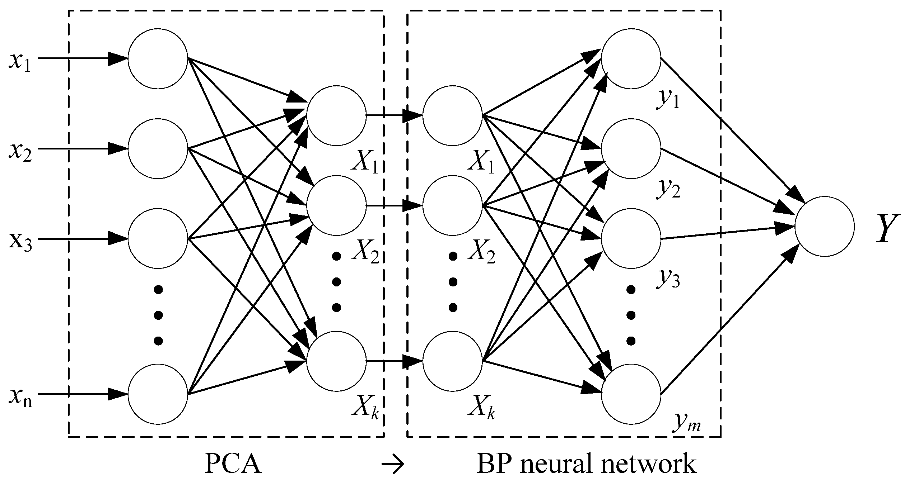
Model 3 - Artificial Neural Network with PCA :
PCA technique of feature reduction is used to reduce the number of input features given to the Artificial Neural Networks to include only those input features which have a maximum impact on the predicted output.
Figure : Artificial Neural Network With PCA

Slide 15
Model 4 - Fuzzy Neural Networks with PCA
The dimension of input features increases when the inputs are converted into their corresponding membership values.
Reduction of dimension of membership values is very important for fast and accurate computation of results.
The membership values that have low belonging to the output class have not been considered for result computation.

Slide 16
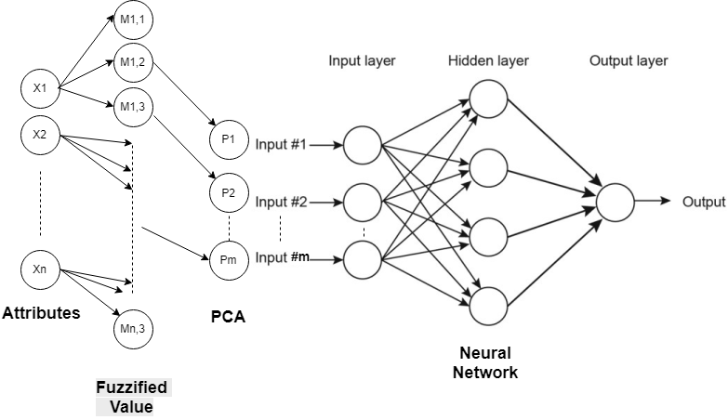
Figure: Block Diagram for FNN with PCA

Slide 17
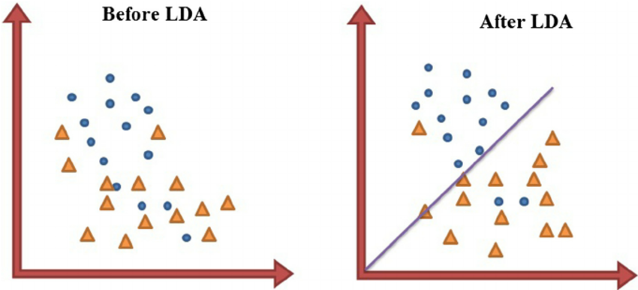
Linear Discriminant Analysis(LDA)
Linear Discriminant Analysis(LDA) is a very common technique used for supervised classification problems.
LDA is a dimensionality reduction technique used as a preprocessing step in Machine Learning and pattern classification applications.
The main goal of dimensionality reduction techinques is to reduce the dimensions by removing the reduntant and dependent features by transforming the features from higher dimensional space to a space with lower dimensions.

Slide 18
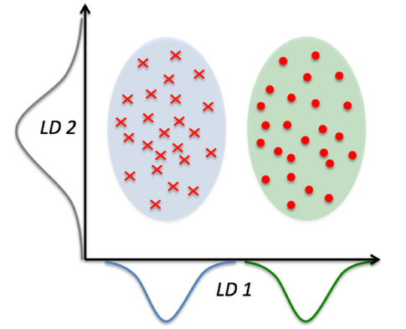
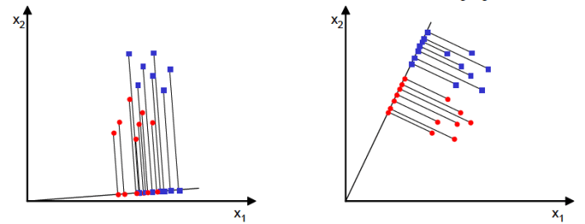
This can be achieved in three steps :
The first step is to calculate the separability between different classes(i.e the distance between the mean of different classes) also called as between-class variance
Second Step is to calculate the distance between the mean and sample of each class,which is called the within class variance
The third step is to construct the lower dimensional space which maximizes the between class variance and minimizes the within class variance.

Slide 19
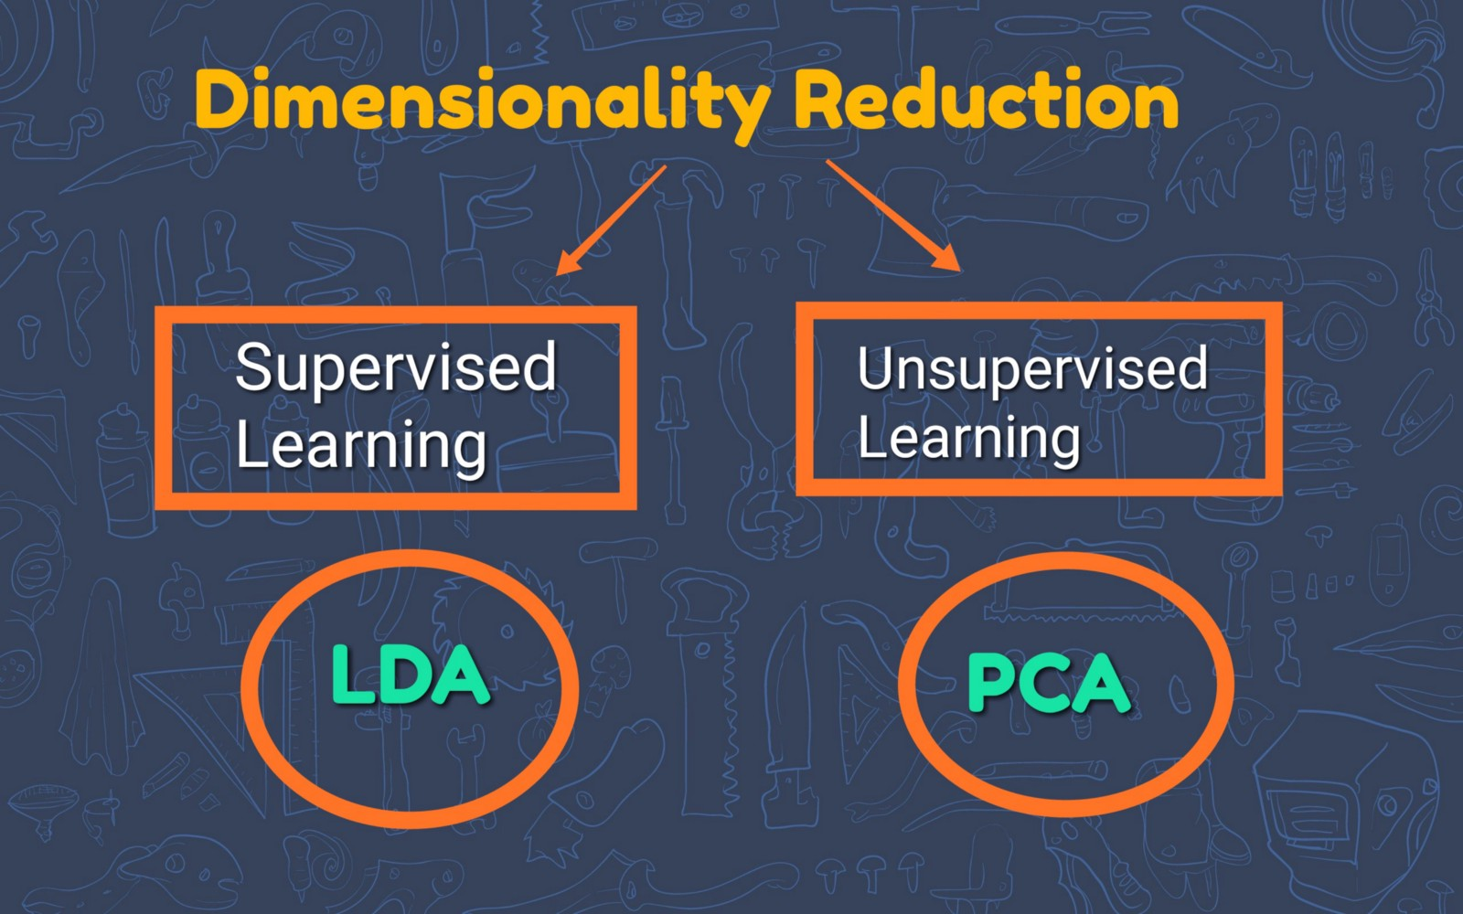
Difference between LDA and PCA
The goal of LDA is to find the feature subspace that optimizes class separability (see figure below). Hence LDA is a supervised algorithm.
PCA is an unsupervised algorithm that is used for feature extraction in high-dimensional and correlated data. PCA achieves dimensionality reduction by transforming features into orthogonal component axes of maximum variance in a dataset.

Slide 20
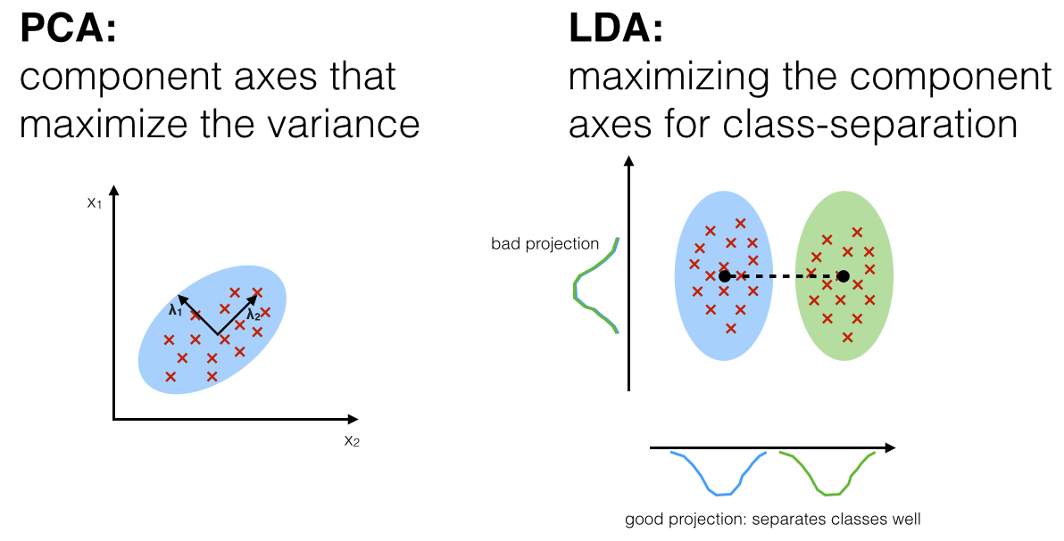

Slide 21
Application and Area of use
Linear Discriminant Analysis is applied in positioning and product management. Other applications are the following:
Bankruptcy prediction
In bankruptcy prediction based on accounting ratios and other financial variables, linear discriminant analysis was the first statistical method applied to systematically explain which firms entered bankruptcy vs. survived.
Face recognition
In computerized face recognition, each face is represented by a large number of pixel values. Linear discriminant analysis is primarily used here to reduce the number of features to a more manageable number before classification.
Marketing
In marketing, discriminant analysis was once often used to determine the factors which distinguish different types of customers and/or products on the basis of surveys or other forms of collected data. .
Biomedical studies
The main application of discriminant analysis in medicine is the assessment of severity state of a patient and prognosis of disease outcome.

Slide 22
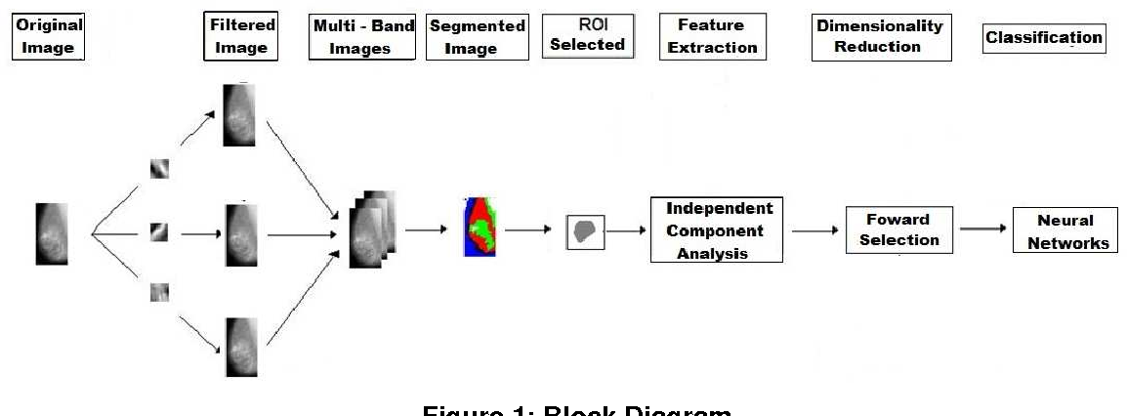
Independent Component Analysis:
In signal processing, independent component analysis (ICA) is a computational method for separating a multivariate signal into additive subcomponents. ICA is able to find the underlying components and sources mixed in the observed data in many cases where the classical methods fail. ICA is a special case of blind source separation. A common example application is the "cocktail party problem" of listening in on one person's speech in a noisy room.

Slide 23
Application Of ICA:
Astronomical data
Text mining
Finding Hidden Factors in Financial Data
Reducing Noise in Natural Images
Telecommunications

Slide 24
Camparison between PCA , LDA and ICA
PCA: Proper to dimension reduction
LDA : Proper to pattern classification if the number of training sample of each class are large.
ICA: Proper to blind source sepration or classification using ICs when class id of training data is not available.

Slide 25
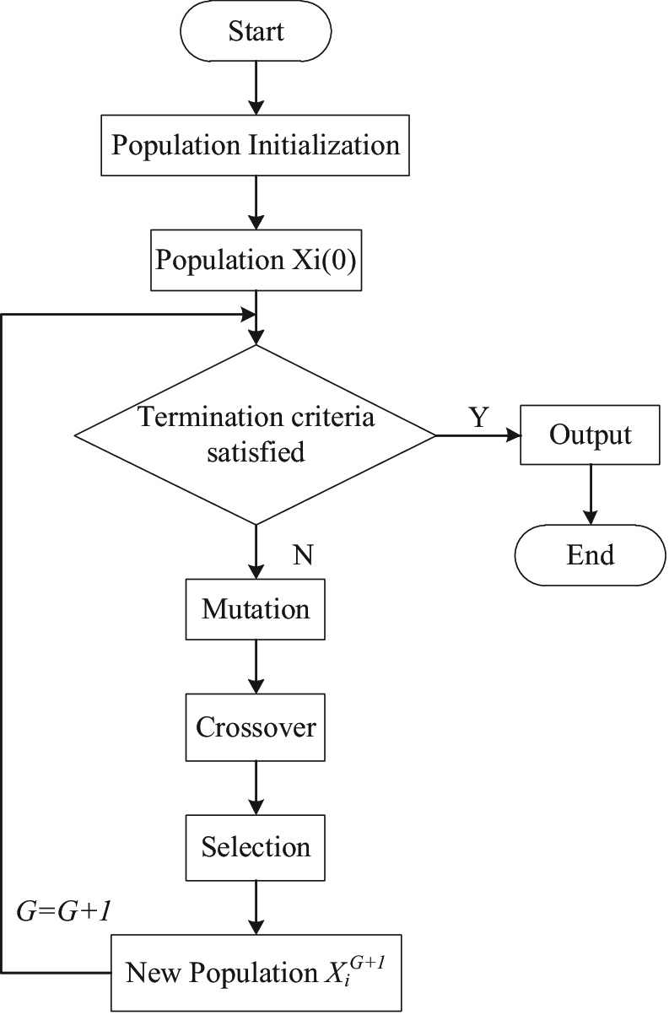
Differential Evolution Algorithm :
It is a stochastic, population-based optimization algorithm for solving nonlinear optimization problem. In evalutionary computation, differential evolution (DE) is a method that optimises a problem by itratively trying to improve a candidate solution with regard to a given measure of quality.
Figure : Flowchart of DE algorithm

Slide 26
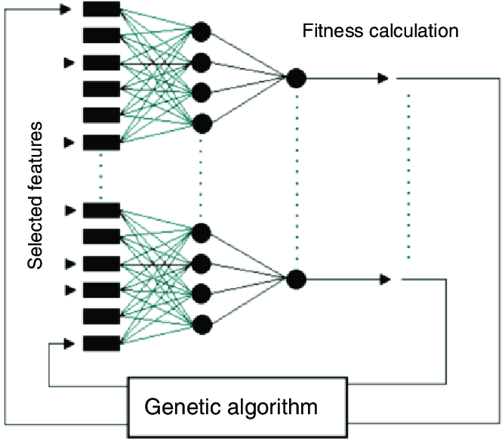
Working of DE optimisation algorithm
Figure : Working of DE algorithm

Slide 27
Result Analysis
 | ANN | NF | ANN-PCA | NF-PCA | ANN-LDA | NF-LDA | ANN-ICA | NF-ICA
BCD | 90.6 | 93.9 | 93.6 | 95.6 | 97.2 | 97.8 | 95.2 | 94.6
Wine | 91.2 | 93.1 | 93.9 | 95.5 | 96.5 | 96.8 | 93.1 | 93.2
Hepatitis | 79.1 | 81.5 | 81.4 | 85.6 | 84.9 | 88.0 | 84.2 | 88.6
Thyroid | 86.7 | 92.3 | 92.5 | 93.1 | 96.2 | 96.3 | 92.8 | 95.5
Liver | 69.2 | 73.7 | 68.6 | 73.9 | 71.3 | 73.9 | 66.2 | 64.8
Table : Accuracy Comparison

Slide 28
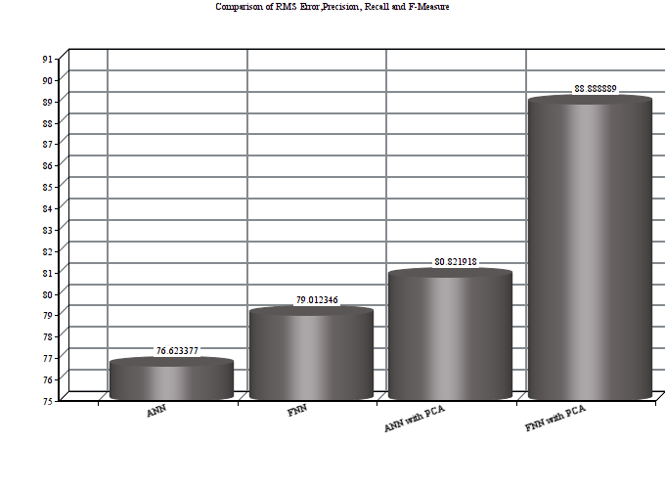
Result and Analysis PCA
Pima Indian Diabetic Dataset
Fuzzy Neural Network with PCA had accuracy of 88.88% is highest among all the implemented models (ANN give’s accuracy of 76.623% , FNN give’s accuracy of 79.012% and ANN with PCA give’s accuracy of 80.82%) .It was most efficient in terms of execution time too.

Slide 29
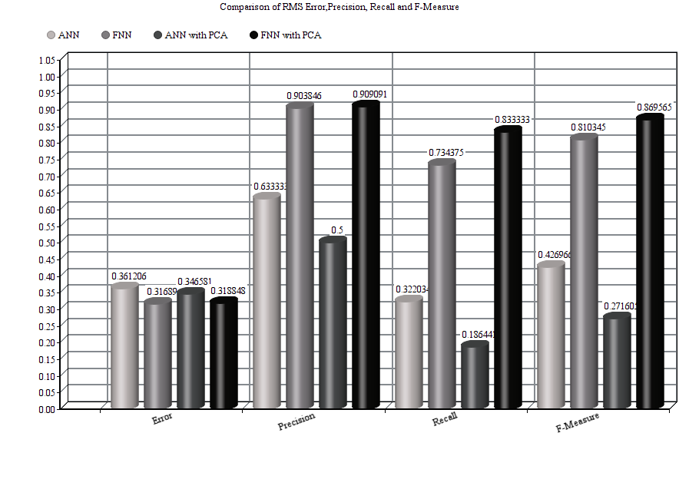
 | RMS Error | Precision | Recall | F-Measure
ANN | 0.3612 | 0.6333 | 0.32203 | 0.4269
FNN | 0.3168 | 0.9038 | 0.7343 | 0.8103
ANN with PCA | 0.3465 | 0.5 | 0.1864 | 0.2716
FNN with PCA | 0.3188 | 0.9090 | 0.8333 | 0.8695
Table: Performance measures of Pima Indian Diabetic dataset for different models

Slide 30
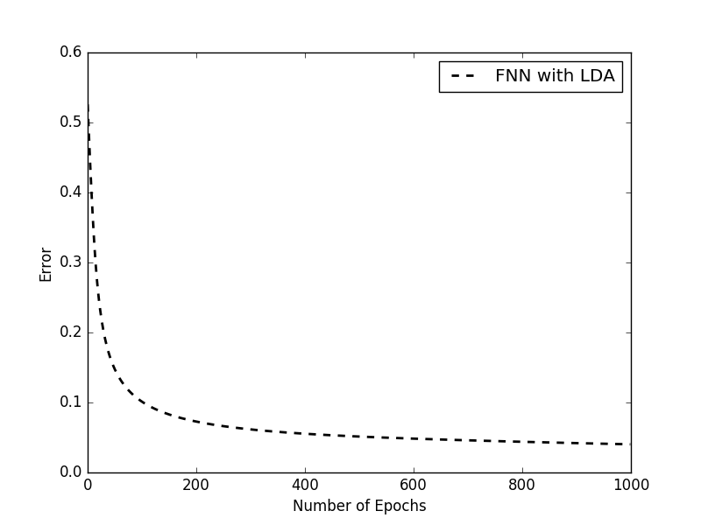
Result Analysis LDA
Result Table
Error plot
Breast-Cancer Wisconsin Dataset
Accuracy | RMS ERROR | Precision | Recall | F-Measure | Time
96.36% | 0.078 | 0.98 | 0.41 | 0.569 | 14.018
97.90% | 0.088 | 0.951 | 0.278 | 0.43 | 14.65
97.67% | 0.077 | 0.951 | 0.314 | 0.472 | 14.16
97.52% | 0.065 | 0.93 | 0.353 | 0.449 | 14.09
96.72% | 0.081 | 0.97 | 0.39 | 0.534 | 14.002
97.02% | 0.072 | 0.98 | 0.327 | 0.439 | 14.15
96.89% | 0.082 | 0.94 | 0.34 | 0.442 | 14.4
97.17% | 0.075 | 0.96 | 0.44 | 0.39 | 14.05
96.14% | 0.071 | 0.389 | 0.48 | 0.42 | 13.45

Slide 31
Table:RMSE Error Plot for ANN,ANN-PCA,ANN-LDA,NF,NF-PCA,NF-LDA
Dataset | RMSE of ANN | RMSE of ANN-PCA | RMSE ofANN-LDA | RMSE of NF | RMSE ofNF-PCA | RMSE of NF-LDA
Pima Indian diabetes | 0.41819 | 0.28248 | 0.25462 | 0.29887 | 0.30353 | 0.305590
Breast Cancer Wisconsin (Diagnosis) | 0.0809876 | 0.01082 | 0.05601 | 0.0451097 | 0.0669 | 0.067951
Breast-Cancer-Wisconsin | 0.41819 | 0.21637 | 0.07655 | 0.17052 | 0.02546 | 0.06669
Mammographic Mass | 0.30163 | 0.26163 | 0.24898 | 0.1914 | 0.18031 | 0.23288
Thyroid | 0.19373 | 0.07685 | 0.04365 | 0.28599 | 0.34237 | 0.02402
Blood Transfusion Service Center | 0.31176 | 0.31284 | 0.170960628 | 0.13597 | 0.29339 | 0.30307
Heart-statlog | 0.17989 | 0.22469 | 0.20753 | 0.2253 | 0.1985 | 0.240866
Lung-cancer | 0.03312 | 0.5406 | 0.1671 | 0.04837 | 0.08123 | 0.2181
SPECTF heart | 0.291 | 0.1211 | 0.199 | 0.129 | 0.169 | 0.059
Haberman | 0.25329 | 0.35470 | 0.3358 | 0.33007 | 0.35749 | 0.33005
Liver | 0.33576 | 0.4430 | 0.4039 | 0.41518 | 0.40686 | 0.35402
Hepatitis | 0.03701 | 0.060 | 0.1860 | 0.172 | 0.178 | 0.2100
Titanic | 0.19373 | 0.07685 | 0.270 | 0.28599 | 0.34237 | 0.2385
Wine | 0.05249 | 0.35470 | 0.04920 | 0.03854 | 0.10774 | 0.082694
Iris | 0.18721 | 0.38248 | 0.08524 | 0.10258 | 0.1170 | 0.10645
Hayes Roth | 0.32242 | 0.35525 | 0.2824 | 0.14770 | 0.1622 | 0.1369

Slide 32
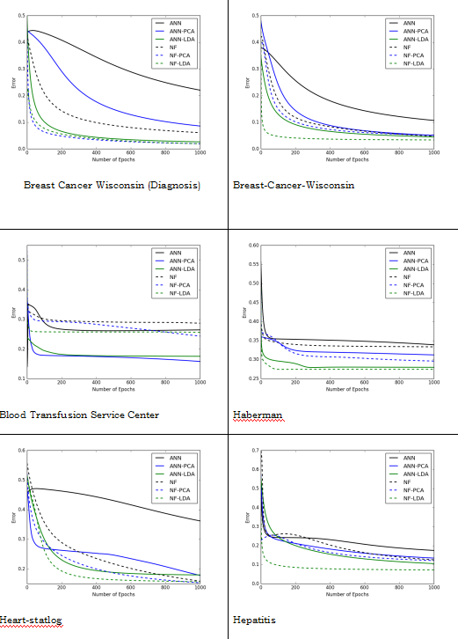
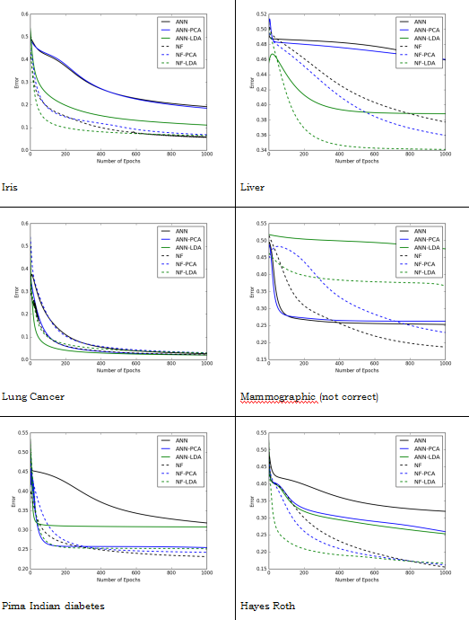
Error Plots of LDA

Slide 33
Table 6: Comparison between precision of ANN,ANN-PCA,ANN-LDA,NF,NF-PCA,NF-LDA models
 | ANN | ANN-PCA | ANN-LDA | NF | NF-PCA | NF-LDA
Pima Indian diabetes | 0.393 | 0.633 | 0.566 | 0.903 | 0.936 | 0.8
Breast Cancer Wisconsin (Diagnosis) | 0.95712 | 0.9649 | 0.9628 | 0.9810 | 0.9465 | 0.9808
Breast-Cancer-Wisconsin | 0.972 | 0.942 | 0.934 | 0.914 | 0.925 | 0.920
Mammographic Mass | 0.733 | 0.808 | 0.787 | 0.846 | 0.852 | 0.8505
Thyroid | 0.953 | 0.933 | 0.95098 | 0.915 | 0.932 | 0.95833
Blood Transfusion Service Center | 0.5015 | 0.129 | 0.486 | 0.7283 | 0.8105 | 0.781
Heart-statlog | 0.5480 | 0.6182 | 0.8354 | 0.79003 | 0.8142 | 0.8647
Lung-cancer | 0.599206 | 0.54605 | 0.6671 | 0.60837 | 0.5993 | 0.6676
SPECTF heart | 0.9011 | 0.8713 | 0.8507 | 0.797 | 0.7623 | 0.6913
Haberman | 0.6233 | 0.7014 | 0.7333 | 0.6335 | 0.5233 | 0.4
Liver | 0.7365 | 0.72086 | 0.63461 | 0.70422 | 0.765 | 0.6724
Hepatitis | 0.8427 | 0.9184 | 0.8996 | 0.596 | 0.5261 | 0.5364
Titanic | 0.762 | 0.840 | 0.7356 | 0.718 | 0.816 | 0.7878
Wine | 0.9155 | 0.8512 | 0.9135 | 0.9361 | 0.9629 | 0.764
Iris | 0.918 | 0.942 | 0.8583 | 0.926 | 0.950 | 0.9111
Hayes Roth | 0.683 | 0.750 | 0.557 | 0.781 | 0.801 | 0.8055

Slide 34
Table: Comparison between Recall of ANN,ANN-PCA,ANN-LDA,NF,NF-PCA,NF-LDA models
 | ANN | ANN-PCA | ANN-LDA | NF | NF-PCA | NF-LDA
Pima Indian diabetes | 0.181 | 0.263 | 0.2654 | 0.750 | 0.723 | 0.684
Breast-Cancer-Wisconsin | 0.359 | 0.327 | 0.366 | 0.343 | 0.324 | 0.330
Mammographic Mass | 0.523 | 0.491 | 0. | 0.545 | 0.532 | 0.5068
Thyroid | 0.751 | 0.831 | 0.7555 | 0.868 | 0.944 | 0.9333
Blood Transfusion Service Center | 0.0839 | 0.1015 | 0.8996 | 0.9923 | 0.97414 | 0.9255
Heart-statlog | 0.74658 | 0.7908 | 0.79509 | 0.2525 | 0.2307 | 0.3005
Lung-cancer | 0.6190 | 0.5992 | 0.666 | 0.65833 | 0.5701 | 0.6444
SPECTF heart | 0.74658 | 0.7908 | 0.8507 | 0.797 | 0.7623 | 0.6913
Haberman | 0.0807 | 0.074 | 0.2291 | 0.0699 | 0.0308 | 0.0416
Liver | 0.64022 | 0.70594 | 0.66 | 0.7346 | 0.6349 | 0.6393
Hepatitis | 0.885 | 0.9002 | 0.8391 | 0.0784 | 0.0683 | 0.0986
Titanic | 0.389 | 0.324 | 0.3926 | 0.681 | 0.686 | 0.62275
Wine | 0.9289 | 0.9437 | 0.9299 | 0.9419 | 0.9544 | 0.943
Iris | 0.910 | 0.942 | 0.85833 | 0.928 | 0.953 | 0.88690
Hayes Roth | 0.706 | 0.751 | 0.7103 | 0.754 | 0.758 | 0.6338

Slide 35
Table: Comparison between Fmeasure of ANN,ANN-PCA,ANN-LDA,NF,NF-PCA,NF-LDA models
 | ANN | ANN-PCA | ANN-LDA | NF | NF-PCA | NF-LDA
Pima Indian diabetes | 0.2457 | 0.36807 | 0.361 | 0.8172 | 0.8147 | 0.720
Breast Cancer Wisconsin (Diagnosis) | 0.7441 | 0.7590 | 0.7723 | 0.766 | 0.7766 | 0.7576
Breast-Cancer-Wisconsin | 0.5005 | 0.49876 | 0.4997 | 0.485 | 0.4796 | 0.4361
Mammographic Mass | 0.498 | 0.532 | 0.549 | 0.532 | 0.660 | 0.6351
Thyroid | 0.8060 | 0.856 | 0.82544 | 0.904 | 0.9116 | 0.9407
Blood Transfusion Service Center | 0.535 | 0.532 | 0.675 | 0.746 | 0.668 | 0.712
Heart-statlog | 0.806 | 0.8281 | 0.820 | 0.38011 | 0.3545 | 0.4167
Lung-cancer | 0.5202 | 0.5837 | 0.592 | 0.5796 | 0.577 | 0.6099
SPECTF heart | 0.8623 | 0.9068 | 0.8665 | 0.1354 | 0.1117 | 0.1652
Haberman | 0.432 | 0.883 | 0.3492 | 0.503 | 0.231 | 0.0754
Liver | 0.6816 | 0.71286 | 0.64705 | 0.71804 | 0.6904 | 0.65546
Hepatitis | 0.8623 | 0.9068 | 0.8665 | 0.1354 | 0.117 | 0.165
Titanic | 0.492 | 0.486 | 0.512 | 0.601 | 0.655 | 0.6956
Wine | 0.9186 | 0.936 | 0.9202 | 0.9352 | 0.956 | 0.9240
Iris | 0.91057 | 0.9401 | 0.8518 | 0.923 | 0.9481 | 0.886
Hayes Roth | 0.6726 | 0.73354 | 0.5643 | 0.751 | 0.7558 | 0.6628

Slide 36
Result Analysis ICA
 | ANN-ICA | NF-ICA
Breast Cancer Wisconsin (Diagnosis) | 0.351896944 | 0.212544297
Breast-Cancer-Wisconsin | 0.090416162 | 0.126503211
Mammographic Mass | 0.486073001 | 0.318301849
Thyroid | 0.152491631 | 0.193272043
Blood Transfusion Service Center | 0.314975183 | 0.25635183
SPECTF heart | 0.283452936 | 0.339696851
Liver | 0.471867005 | 0.481731111
Hepatitis | 0.21330813 | 0.176598428
Titanic | 0.356606866 | 0.29955751
Wine | 0.078640561 | 0.212026417
Iris | 0.141162016 | 0.15947706
Hayes Roth | 0.377100898 | 0.172625415
Table 9 : RMS Error comparison

Slide 37
 | ANN-ICA | NF-ICA
Breast Cancer Wisconsin (Diagnosis) | 0.901846523 | 0.955765657
Breast-Cancer-Wisconsin | 0.937619345 | 0.938488256
Mammographic Mass | 0.768499224 | 0.83299485
Thyroid | 0.963502533 | 0.97979
Blood Transfusion Service Center | 0.696825397 | 0.813082905
SPECTF heart | 0.866018928 | 0.867646
Liver | 0.637609306 | 0.639341111
Hepatitis | 0.87416035 | 0.72047619
Titanic | 0.86072925 | 0.802584922
Wine | 0.938173591 | 0.938495389
Iris | 0.916395965 | 0.92781074
Hayes Roth | 0.61715815 | 0.779251304
Table : Precision Comparison between ANN - ICA and FNN - ICA

Slide 38
Conclusion:
From this research it was concluded that
1. NF model performed better than ANN model (Accuracy).
2. Among the feature reduction techniques (PCA,LDA,ICA) the LDA and ICA model had better perfomance than PCA both in terms of accuracy and execution time.
3. The DE optimization algorithm (feature selection technique) perforns better than feature reduction technique for large dataset
Future Scope:
Neuro-Fuzzy Systems which are a combination of soft computing and machine learning techniques are used in disease diagnoses like brain disorder, cardiac disease, breast cancer, alzheimer, thyroid disorder, leukemia, hypertension.It is also extensively used in medical image classification and recognition.

Slide 39


